Slide 1
Implementing DevOps practices to accelerate developer productivity

Slide 2
Setup Development Environment
Exercise 1

Slide 3
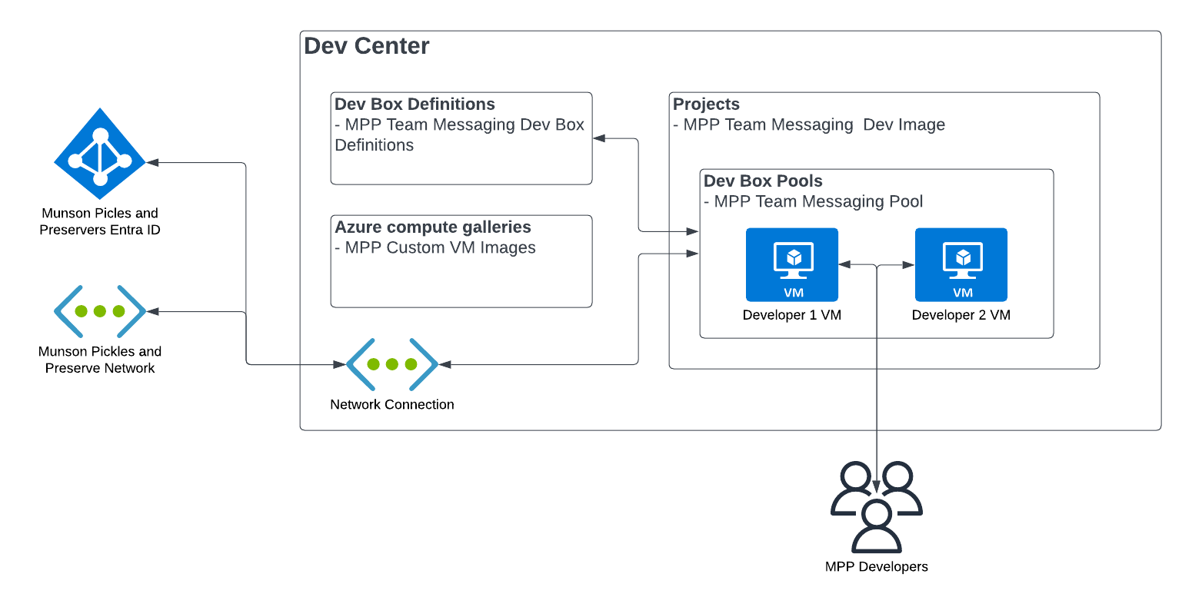
Lab 1 Architecture
Azure Dev Box
Notes:
The Challenges will focus on creating a custom Dev Box setup for Munson’s Pickles and Preserves
Challenge 01: Set up development environment
For Dev Box, most of the configuration aspects of it are contained with the Dev Center service in Azure. The only two things that really need to live outside of it are the network you wanth the dev boxes to connect to as well as either Active Directory or Entra ID (Azure AD) for user authentication. In our case, we’ll just create a basic network to connect to, but in a customer scenario, this could be their corporate network or the network all the development servers are on, or any other network they’ve created with resourced needed by the Developers. For Authentication, Active Directory or Microsoft Entra ID can be used. Most enterprise customer will probably still have AD they may want to use, but again for simplicity in this lab, we’ll just use Microsoft Entra ID.
The only other thing that you may need to do outside of Dev Center is if you need a custom image like we’ll create in this exercise. If you just want to use one of the Microsoft Provide images, you can create a Dev Box from a standard Image as well.
Within Dev Center, there are several components:
- Dev Box Definitions: These are just custom images you’ve created and defined to be used within the Dev Center.
- Azure computer galleries: This as the galleries in Azure that hold the custom images used to create your Dev Box Definitions.
- Network Connection: Within Dev Center, you need to specify a network connection that you will use to connect the VMs in Dev Center to a network of your choosing.
- Projects: Projects are the particular development project a dev box belongs to. This enables you to even setup permissions at the project level so someone outside of “normal” Azure administration could define dev box and setup permissions for developers to be able to login and use Dev Box
- Dev Box Pools: This is a virtual machine pool. Each pool is assigned a dev box definition. Developers can be assigned to one or more pools. The developer can then create and access a Virtual Machine within that pool to perform their development activities. Administrators can see how many virtual machines have been created in each pool.

Slide 4
Introductions: Set up development environment
In this lab, you’ll setup a development environment
After completing this lab, you’ll be able to:
Deploy the necessary infrastructure for an Azure Dev Box
Create an image for your Dev Box
Create a Dev Box
Grant users permissions to create and access their Dev Box
Notes:
Speaker notes:
To start of this series of labs, you need a box with the appropriate software and configuration to be able to perform various development activities.
This lab will guide you through all the steps necessarily to be able to setup and configure Dev Box in Azure the way the architecture was defined. You’ll be able to use that Dev Box to perform that various development activites through the rest of this training and have the software pre-installed in the custom image you’ll create.
In this lab, you’ll create Dev Box, create a custom image, assign that image to Dev Box and create a Dev Box to be used for the training.
Learning objectives
After completing this lab, you'll be able to:
Setup the Azure Dev Box Service
Create a VM that can be used to configure a custom image to be used in Dev Box
Assign that custom image to a Dev Box definition and subsequent Dev Pool
Configure permissions so users an create and login to their dev box

Slide 5
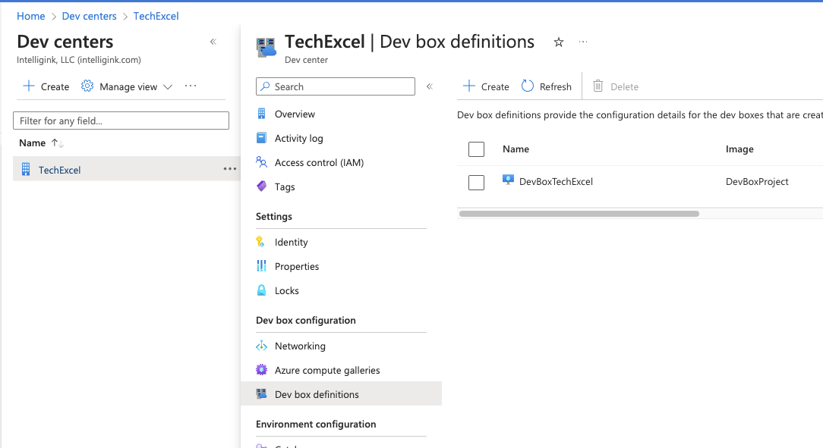
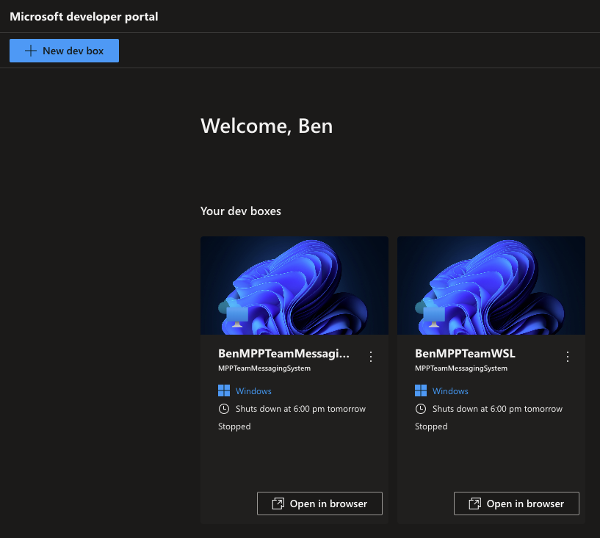
Create a Dev Box definition
Notes:
Speaker notes:
Azure Dev Box enable you to create multiple Dev Box configurations/definitions within Azure. This provides a couple advantages. First, you can create a standard image so you know all your developers are starting on a common framework with the same software and versions of the software installed. Since you can also create multiple definitions, you can have separate denifitions for all of your products. If a developers needs to switch between projects they are developing, they can easily spin up and switch between VMs. This isolates the environments from each other, so developers are worried about effecting their configuration for one development project when when working on a second development projects.
Using Dev Box, also creates a secure way to connect to the virtual machine as it uses the Azure Virtual Desktop infrastructure under the covers. So rather than connecting to a development machine over RDP, they can use the browser or the Remote Desktop client to connect to a Dev Box workspaces associated with their corporate account too remotely connect to the dev box to perform their activities.

Slide 6
Start working in GitHub

Slide 7



Lab 2 Architecture
Your GitHub repository
GitHub Project board
Application
Issues
Issue 1 – Done
Issue 2 - New
Issue 3 - New
Issue 4 - New
Issue 5 - New
InfrastructureAsCode
Clone
.github
Lab
GitHub repository
workflows
first-workflow.yml
Notes:
This lab will focus on cloning the code repository into your environment, configuring a GitHub project and project board, and creating a GitHub Actions workflow.

Slide 8
Introductions: Start working in GitHub
In this lab, you’ll begin by creating a GitHub repository. From there, you will create a GitHub Project and associate issues with that project. Finally, you will create a simple GitHub Actions workflow.
After completing this lab, you’ll be able to:
Create a GitHub repository.
Create a GitHub Project.
Assign issues to teammates and navigate a project board.
Add custom fields to issues.
Create a GitHub Actions workflow.
Extend a GitHub Actions workflow with multiple jobs.
Incorporate workflow actions from the GitHub Marketplace.
Notes:
Speaker notes:
In the previous lab, you create a Dev Box to perform development work.
In this lab, you will create a GitHub repository and work through some of the mechanics of GitOps, including project board management, issue management, and the creation of a GitHub Actions workflow.
Learning objectives
After completing this lab, you'll be able to:
Create a GitHub repository
Create a GitHub Project
Assign issues to teammates and navigate a project board
Add custom fields to issues
Create a GitHub Actions workflow
Extend a GitHub Actions workflow with multiple jobs
Incorporate workflow actions from the GitHub Marketplace

Slide 9
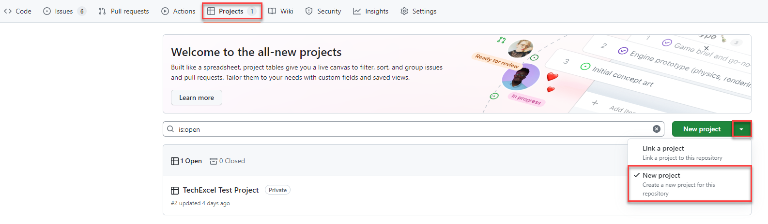
Create a GitHub Project
Notes:
Speaker notes:
GitHub Projects allow development teams and project managers to manage issues, using either a scrum or kanban motif.

Slide 10
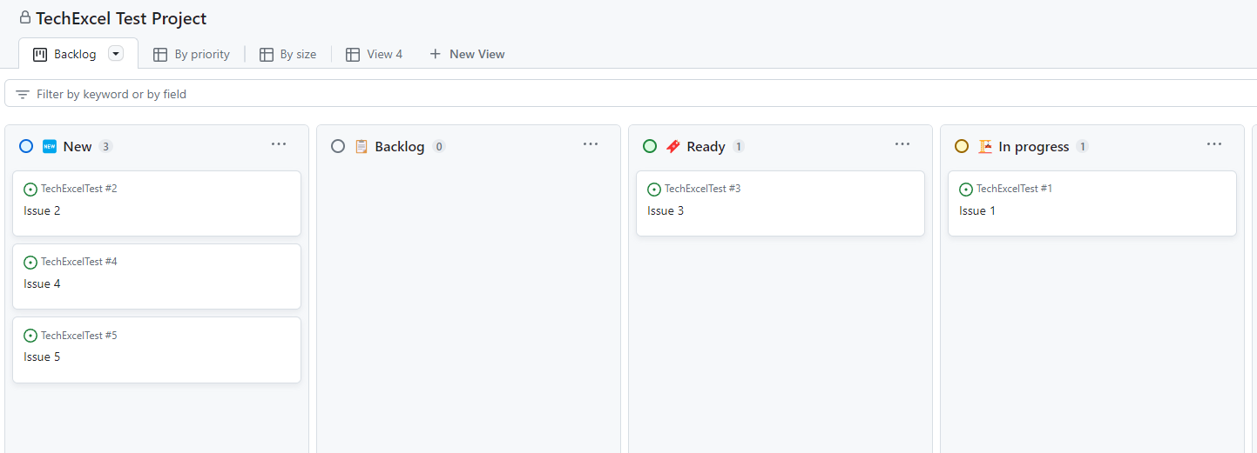
Navigate the project board
Notes:
Speaker notes:
You will create a series of issues on a project board and see how you can manipulate the board to keep track of the status of issues. You will assign issues to teammates and add a custom field to issues.

Slide 11
Create a GitHub Actions workflow
You’ll create the first of several GitHub Actions workflows.
name: First Workflow
on:
workflow_dispatch:
issues:
types: [opened]
jobs:
job1:
runs-on: ubuntu-latest
steps:
- name: Step one
run: echo "Log from step one"
- name: Step two
run: echo "Log from step two"
job2:
needs: job1
runs-on: ubuntu-latest
steps:
- name: Cowsays
uses: mscoutermarsh/cowsays-action@master
with:
text: 'Ready for prod--ship it!'
color: 'magenta'
Allow the workflow to run manually.
Each workflow has one or more jobs. We will create two jobs.
Each workflow job has one or more steps.
You’ll include the cowsays action from the GitHub Marketplace.
Notes:
Speaker notes:
GitHub Actions workflows allow you to perform actions on specific events, such as push code into a branch, creating a pull request, creating an issue, or manual execution.
For this first workflow, you will create a workflow which executes manually. In it, there will be two jobs. The first job will write statements into logs. The second will use the “cowsays” action from the GitHub Marketplace to write a statement into the logs.

Slide 12
Improve and deploy your application

Slide 13




Lab 3 Architecture
Munson’s Pickles & Preserves application architecture
App Service Plan
App Insights
App Service (Dev)
App Service (Test)
App Service (Prod)
Container Registry
Notes:
This lab will focus on deploying the Munson’s Pickles and Preserves Team Messaging System application into Azure.

Slide 14
Introductions: Improve and deploy your application
In this lab, you’ll deploy Azure resources and introduce CI/CD pipelines to your GitHub repo.
After completing this lab, you’ll be able to:
Configure GitHub Copilot and use it to assist with C# code changes.
Deploy ARM and Bicep templates via GitHub Actions workflow.
Create a GitHub Actions workflow for deploying .NET web applications.
Automatically build and deploy a Docker image as part of a workflow.
Update an Azure Web App whenever the GitHub Actions workflow deploys a new Docker image.
Notes:
Speaker notes:
You've created a GitHub repository containing application code and a Bicep script. In this lab, you will create resources in an Azure resource group, including an App Service Plan, three App Services, one Application Insights service, and one Container Registry. You will also use GitHub Copilot in Visual Studio Code to assist you with making a change to the Team Messaging System.
After deploying Azure resources, you will create a new GitHub Actions workflow that builds and deploys a Docker container image based on the .NET web application code. Then, whenever the application code changes, you will build a new image, deploy it to the Container Registry, and use that new image in your App Services.
Learning objectives
After completing this lab, you'll be able to:
Configure GitHub Copilot and use it to assist with C# code changes
Deploy ARM and Bicep templates via GitHub Actions workflow
Create a GitHub Actions workflow for deploying .NET web applications
Automatically build and deploy a Docker image as part of the workflow
Update an Azure Web App whenever the GitHub Actions workflow deploys a new Docker image

Slide 15
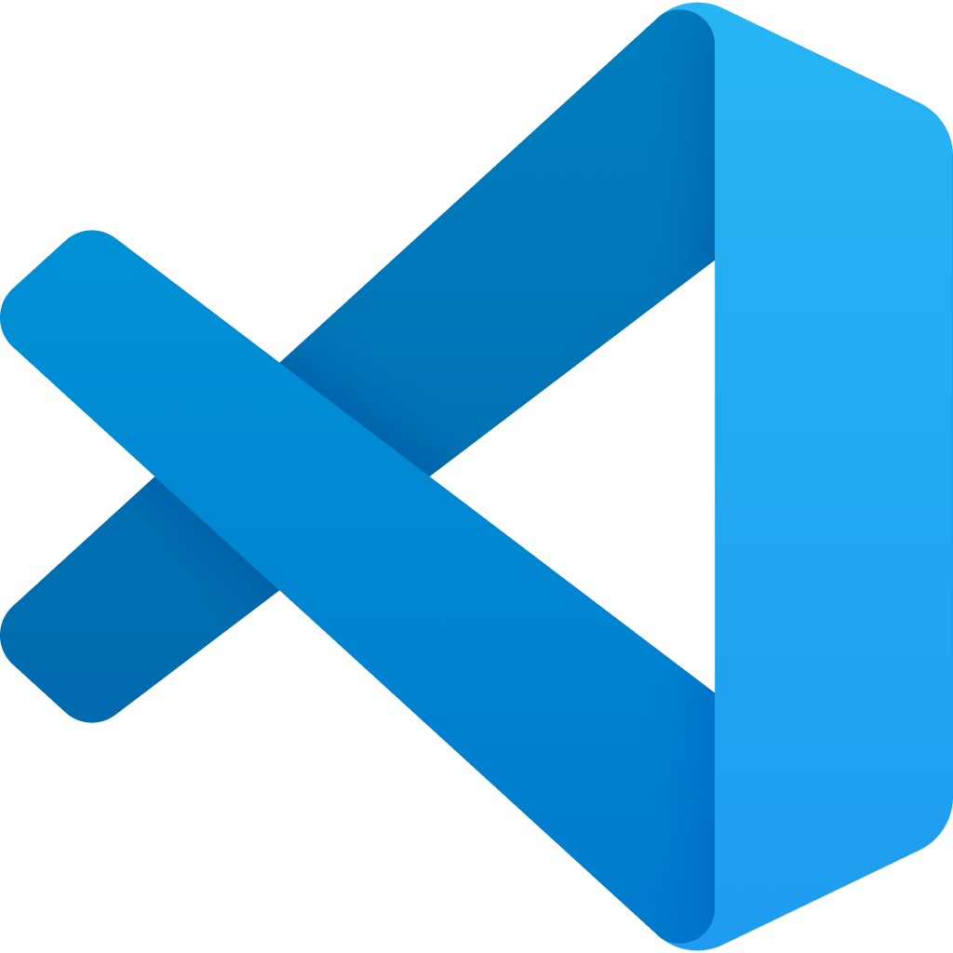
Follow the GitHub Flow
The GitHub Flow is a common process for managing code changes through GitHub.
Create a GitHub Issue
Create a feature branch
Fetch repo changes locally
VS Code
Commit and push changes
GitHub allows you to tie issues, branches, and pull requests together, letting GitHub close issues and delete feature branches after code moves to the main branch.
Pull request to main
Code review
Complete pull request
Notes:
Speaker notes:
The GitHub flow is a standard process for making code changes in a GitHub repository. There are several steps to the GitHub flow:
Create a GitHub Issue describing the problem you would like to solve. This may involve discussion with team members, project managers, issue reporters, and relevant stakeholders. The GitHub Issue should include enough details to prompt a code change.
Create a new branch. This new branch, called a feature branch, will allow you to work on your code independent of other developers. It will also allow you to experiment without breaking important code release branches like a development or main branch.
After creating the new branch, fetch changes locally and switch to the newly created feature branch. At this point, any changes you make locally will be in the feature branch, isolating your changes from others.
Make any necessary changes in tools like Visual Studio Code. If you have correctly configured Visual Studio Code and installed the C# extension, you should be able to run the .NET web application locally and try it out in a browser.
After you have completed all code changes, you can commit these changes locally. Then, when you are ready to complete the task, you can push your changes to the remote feature branch.
After you have pushed your changes, you can create a pull request. In this case, we will pull request directly to the main branch, though some repositories may have a series of branches such as dev, test, and main.
A teammate should perform a code review of the code in your pull request. This allows a second set of eyes to review the code changes and ensure that these are appropriate and correct changes.
After the code review completes, completing the pull request is the final step. In this process, you may wish to delete the feature branch and close the originating issue.

Slide 16
Deploy a Bicep template
GitHub allows you to execute ARM and Bicep templates as part of a GitHub Actions workflow.
To deploy resources, you will need to log into Azure and then use the arm-deploy action.
- uses: azure/login@v1
with:
creds: ${{ secrets.AZURE_CREDENTIALS }}
- name: Run ARM deploy
uses: azure/arm-deploy@v1
with:
subscriptionId: ${{ secrets.AZURE_SUBSCRIPTION_ID }}
resourceGroupName: ${{ secrets.AZURE_RG }}
template: ./InfrastructureAsCode/main.bicep
parameters: environment=${{ github.event.inputs.appenv }}
The action above will deploy a file called main.bicep to Azure whenever the GitHub Actions workflow runs.
Notes:
Speaker notes:
GitHub allows you to execute ARM and Bicep templates as part of a GitHub Actions workflow. To do this, you can use the azure/arm-deploy action from the GitHub Marketplace. It needs several parameters, including a subscription ID, a resource group name, the location of the ARM or Bicep template file, and a set of input parameters.
The arm-deploy action can work with both ARM and Bicep templates because Bicep is fully translatable into ARM.
You will create a GitHub Actions workflow to perform this operation. In practice, this would allow you to automate resource changes whenever the Bicep template changes, automating your Infrastructure as Code process.

Slide 17
CI/CD for .NET websites with GitHub Actions
Create another GitHub Actions workflow for deploying the website
steps:
- uses: actions/checkout@v3
- name: Setup .NET
uses: actions/setup-dotnet@v3
with:
dotnet-version: 6.0.x
- name: Restore dependencies
run: dotnet restore
- name: Build
run: dotnet build --no-restore
- name: Test
run: dotnet test --no-build
Create a GitHub Actions .NET workflow and configure each of the steps.
Add environment variables to manage deployment.
Build a Docker image from the .NET code and deploy it to Azure Container Registry. Then, update the Web App with that new container image.
Notes:
Speaker notes:
The final step in this lab is to create a Continuous Integration and Continuous Delivery (CI/CD) process for deploying the .NET website. You will use yet another GitHub Actions workflow, this one based around .NET CI/CD. The core of this workflow includes three commands: dotnet restore to restore any dependencies in NuGet packages, dotnet build to compile the application and create binaries, and dotnet test to run unit tests against the compiled binaries.
In addition, you will extend this workflow to build a Docker image from the .NET code and deploy it into an Azure Container Registry. Then, for each newly tagged image, you will update each environment’s Web App with that container image.

Slide 18
Implement load testing secure practices

Slide 19


Lab 4 Architecture
Munson’s Pickles & Preserves application architecture
App Service Plan
App Insights
Chaos Experiment
App Service (Dev)
App Service (Test)
App Service (Prod)
Container Registry
Load Testing
Notes:
This lab will focus on extending the current Azure solution to include load testing and Azure Chaos Studio.

Slide 20
Introductions: Implement load testing and secure practices
In this lab, you’ll create an Apache JMeter load test, use this load test in an Azure Load Test service, and design a chaos experiment using Azure Chaos Studio.
After completing this lab, you’ll be able to:
Design a load test for a web application.
Create a load test using Apache JMeter.
Create an Azure Load Testing service and execute the JMeter load test in Azure.
Design and create a stress test using the Azure Load Testing service.
Design a chaos experiment in Azure Chaos Studio.
Notes:
Speaker notes:
Now that the Team Messaging System website is up and running, it would be beneficial to understand how well the application performs under load. To do this, you will design a load test scenario and then implement it using Apache JMeter, an open source solution for load testing.
After running the load test manually, you will create an Azure Load Testing service. The Load Testing service supports importation of JMeter scripts, so you will be able to use the work you’ve created so far and create a performance baseline for the application. You may also be able to observe performance issues in particular actions, which you can remedy.
After that, you will extend the load test to become a stress test, attempting to push enough traffic at the website to generate failure. You will also use Azure Chaos Studio to generate a chaos experiment, learning how the application behaves when certain services fail.
Learning objectives
After completing this lab, you'll be able to:
Design a load test for a web application
Create a load test using Apache JMeter
Create an Azure Load Testing service and execute the JMeter load test in Azure
Design and create a stress test using the Azure Load Testing service
Design a chaos experiment in Azure Chaos Studio

Slide 21
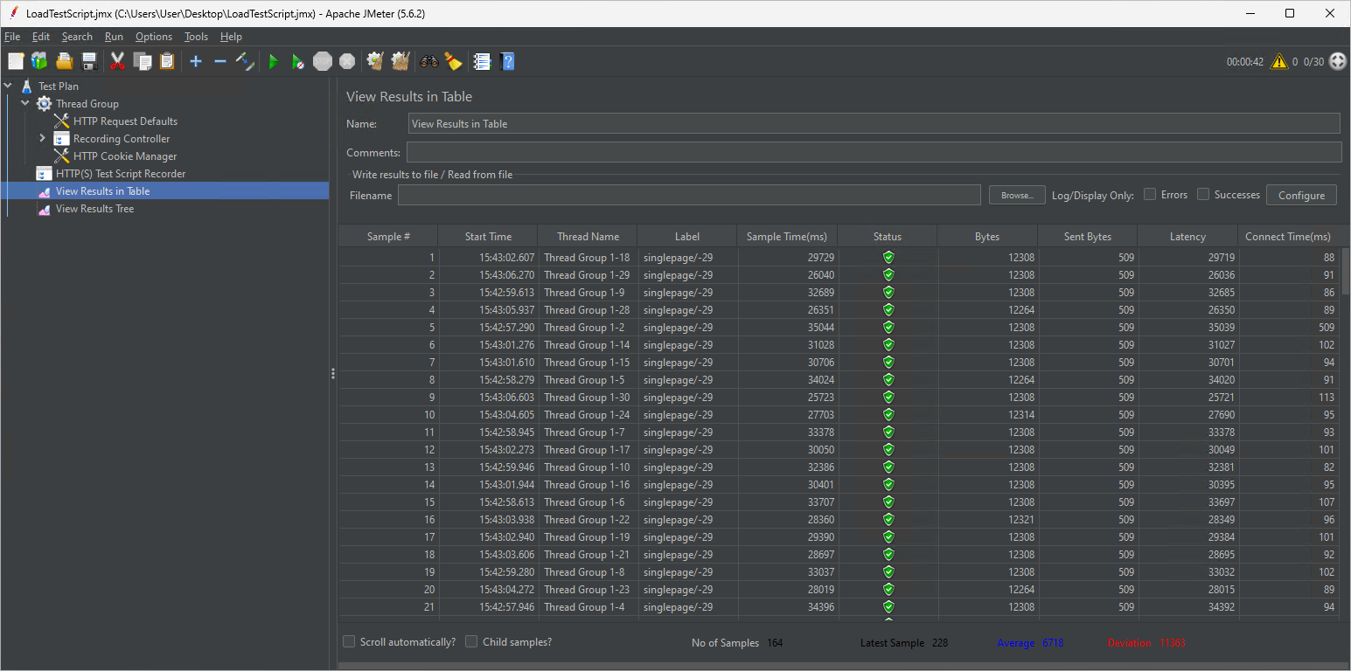
Build and run a load test
Apache JMeter is an open source tool for building and running load test scripts.
Apache JMeter
A load test allows us to simulate a certain amount of traffic against an application to ensure that the application can handle that level of load.
Notes:
Speaker notes:
Apache JMeter is an open source tool for building and running load test scripts. It requires Java 8 or later to be installed and was one of the tools you installed on your Dev Box. You will be able to build a load test using the JMeter GUI, after which you can either run the test in the GUI itself or via command line.
These load tests allow us to simulate a certain amount of traffic against an application. You will design the test and specify how many concurrent users will run this workload. The intent is to ensure that the App Service you created will be able to handle a certain amount of traffic without failure.

Slide 22
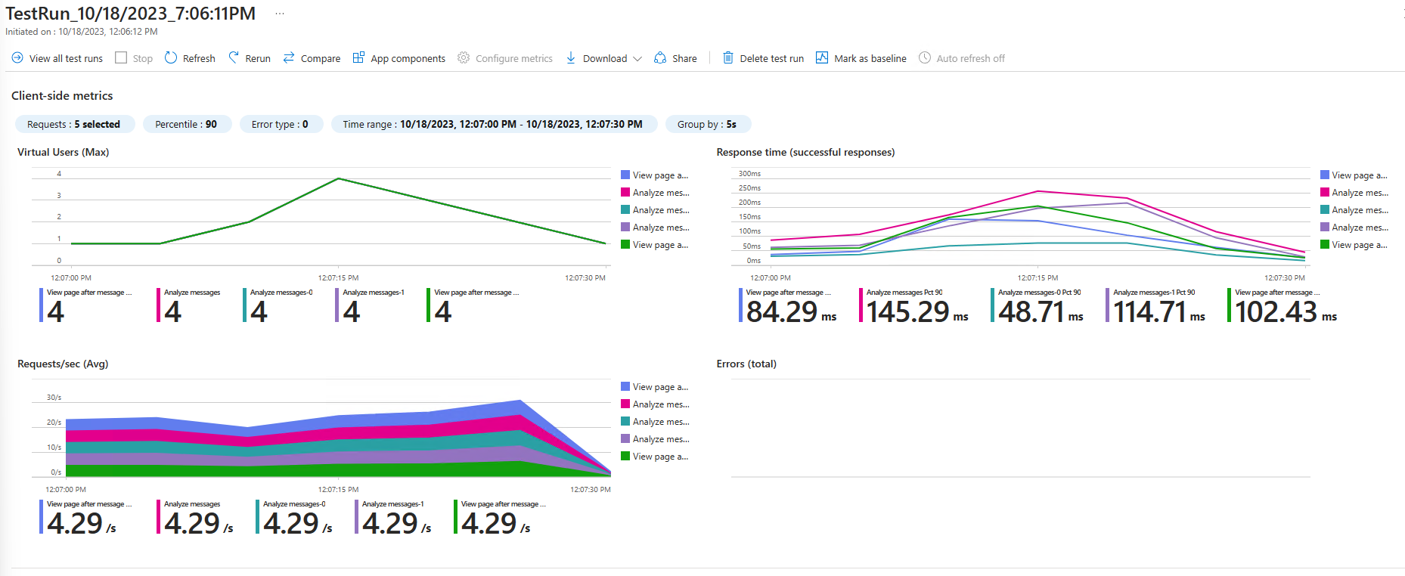
Working with Azure Load Testing
Notes:
Speaker notes:
In addition to running load tests directly via JMeter, you will also create an Azure Load Testing service and run load tests from it. Azure Load Testing accepts JMeter scripts, so you can use the script you have already created as the basis for additional testing. This will provide you with additional information on response times and allow you to link your load test to specific Azure resources and see how the level of load affects those services.
For this lab, you will link the load test to your App Service.

Slide 23
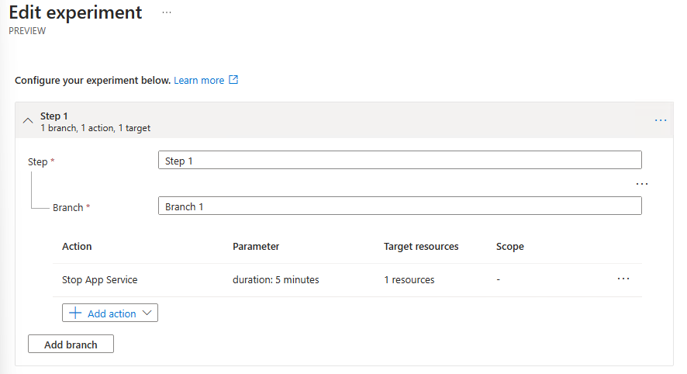
Build an Azure Chaos experiment
You’ll create a chaos experiment to observe behavior when the App Service stops.
Azure Chaos Studio allows us to design experiments that disable resources and test the resiliency of applications.
During the experiment, you will run a load test to simulate activity, observing what happens when a service fails.
Notes:
Speaker notes:
Load testing is not the only form of testing you can run in Azure. You can also run chaos experiments to simulate service failures.
Azure Chaos Studio allows you to design experiments that disable specific resources for a given amount of time. Azure Chaos Studio is currently in preview and supports a limited number of services, so for this lab, we will stop the App Service for a fixed amount of time, seeing how it impacts a running load test.

Slide 24
Make things secure
Exercise 5

Slide 25
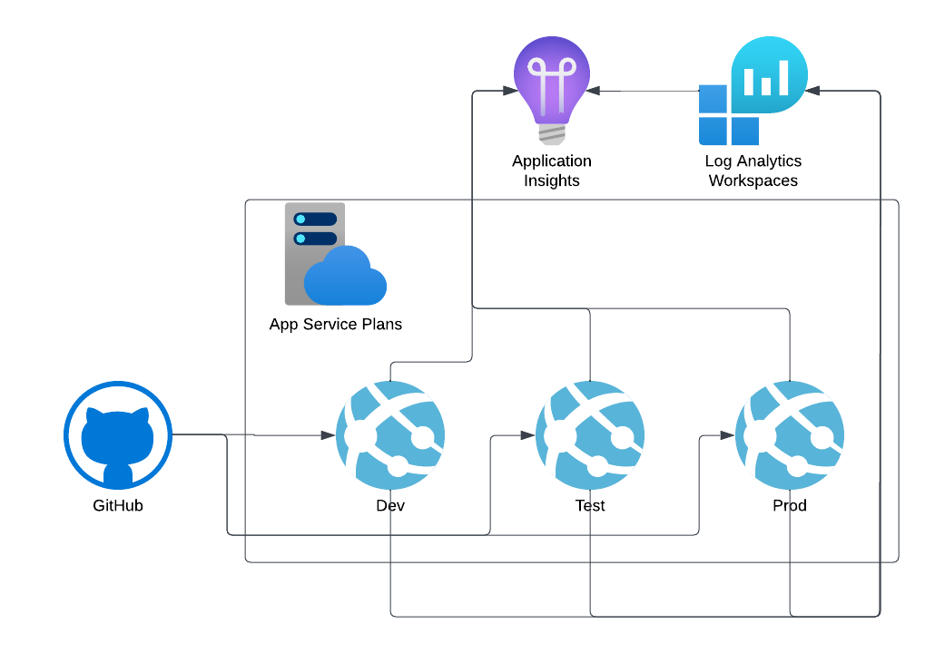
Lab 5 Architecture
Notes:
The Challenges will focus on securing and monitoring you application deployments and GitHub.
Application code can be deployed from GitHub to Dev, Test, and/or Production within an Azure App Service Plan. When thinking about Security, you have both GitHub security to consider as well as the security of your applications.
We’ll start this exercise by looking at security measure you can take in GitHub and then look at how you can monitor you application using a Log Analytics Workspace and Application Insights.

Slide 26
Introductions: Security & Monitoring
In this lab, you’ll add security to GitHub and monitoring to you application
After completing this lab, you’ll be able to:
Configure branching in GitHub
Setup protected branches
Setup a GitHub security policy
Configure code security and vulnerability scanning
Create app monitoring dashboards
Configure app availability monitoring
Notes:
Speaker notes:
You've created you application and setup deployments and pipelines from GitHub into your Azure Apps.
Now that you pipeline is setup, you’ll look at various configuration options including branching and code scanning in GitHub. Then you’ll look at app monitoring within Azure Application Insights.
In this challenge, you'll add security to your application development process.
Learning objectives
After completing this lab, you'll be able to:
Configure branching in GitHub
Setup protection on a GitHub branch, for instance your main branch that deploys your code to your web application
Deploy GitHub security policies and cod security and vulnerability scanning solutions
Monitor your app with Application insights as well as perform availability monitoring of your application with App Insights.

Slide 27
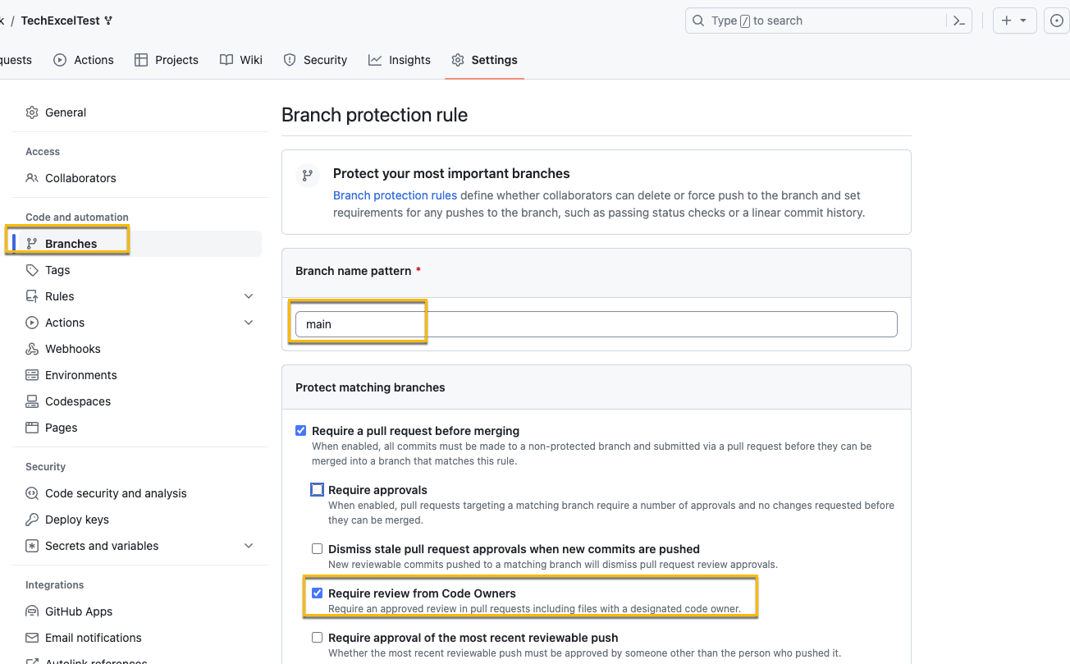
Branch Policies
Branch Policies prevent committing code directly to production without review
The rule above protect the main branch and require review from Code Owners
Notes:
Speaker notes:
Azure Branch policies are a feature in GitHub that you can leverage to help protect code from going straight from the developers machine to production. You can set this up on branches matching specific patterns or, in the case here, just set them against a single branch by setting tha pattern to the branch name.
With branch protection on, you can require reviews from code owners, approvals, and other requirements that must be met before the code is pushed to production. This puts that extra layer or protection in place on the GitHub repo to force the use of branching and enforce reviews and sign-off before code from a branch is committed to the production code.

Slide 28
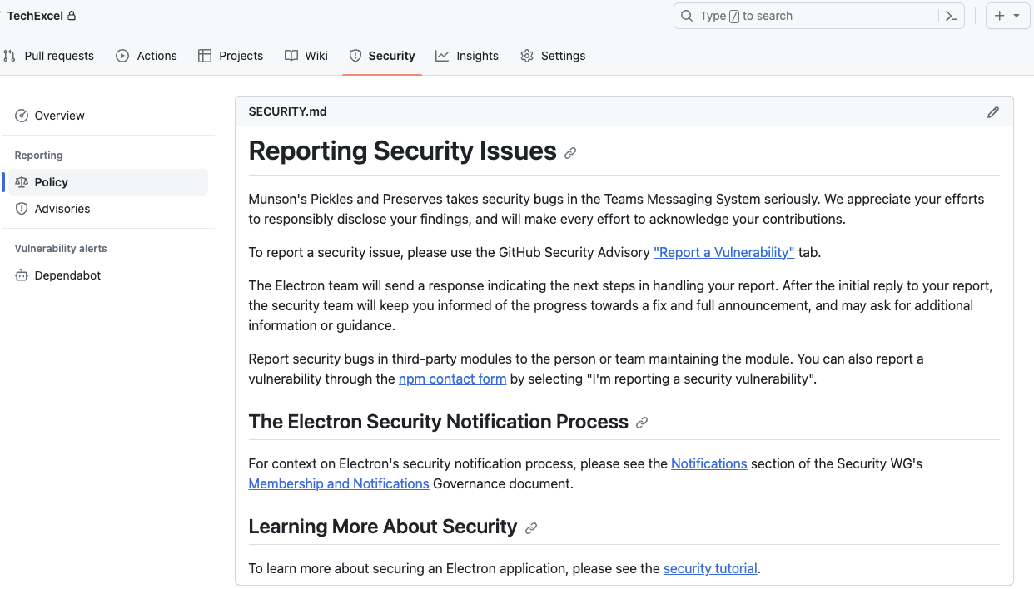
Setup a security policy for a GitHub Repo
GitHub allows you to write your own securityy policy in Markdown and place it into the repo to be surfaced in the security tab.
A security policy enables you to inform those accessing the repo about the security policy as well as how to handle any security issues or vulnerabilities.
Notes:
Speaker notes:
Security policies don’t provide any security to the co pre-se, but do allow you to define what the security policy is for the particular repo. That way, if there is a security issue, developers know how to handle it and what the process is. While it shows up under Security → Policy in GitHub, it’s simple a SECURITY.md file that’s added to the code repo. The security policy can contain reporting guidelines, notification processes, and links to other security resources related to the repository.

Slide 29
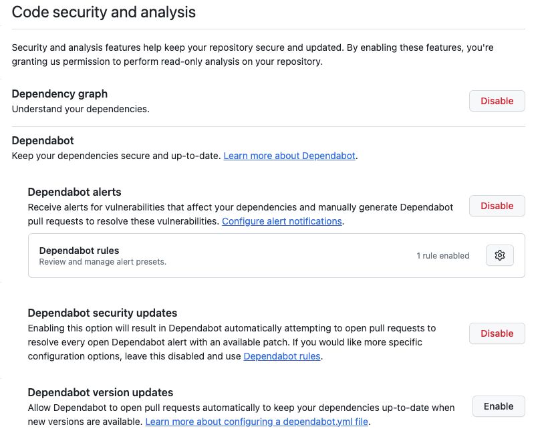
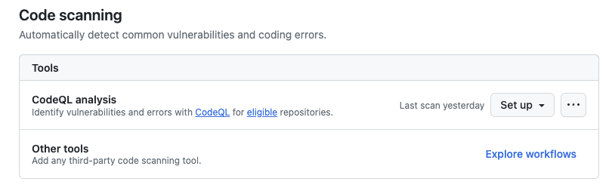
Code security and analysis
With code security and analysis, you can look for vulnerabilities. For CodeQL the repo must be public.
In this procedure, you’ll enable the following items:
Dependabot
CodeQL
Notes:
Speaker notes:
Now that you have branch production in place to prevent code from being being published directly to production as well as a security policy defined for your users, we’ll take a look at setting up code security scanning and alerting. The two features that we’ll look at specifically are Dependabot and Code QL.
Dependabot is used to watch for any vulnerabilities related to code dependencies. Developers don’t always have the time, or even the ability to actively keep up with any vulnerabilities related to dependencies and 3rd party libraries and packages being used for their development project. By enabling Dependable alerts and rules on the GitHub repo, GitHub will watch for and alert when a dependency has a vulnerability that could affect the security of your own code. You can also configure it to not only just alert on the issues, but to also generate pull requests to update the dependencies to resolve the vulnerability.
CodeQL, while dependabot is used to help alert and manage vulnerabilities related to dependancies, CodeQL is used to analyze your own code for vulnerabilities and errors that could effect your code security. CodeQL is an open-source rep that can be used with the Advanced Security in GitHub. There are standard code scanning configurations you can use, but you can also right your own code scanning. CodeQL simply leverages a GitHub action to do things like automatically scan your code anytime there is an update committed to your repo or regular scans based on a schedule. There are some restrictions around CodeQL. If you are using a free account GitHub, you can only use CodeQL on public repos. If you want to use it on a private repo, you do need to be using a paid GitHub account.

Slide 30
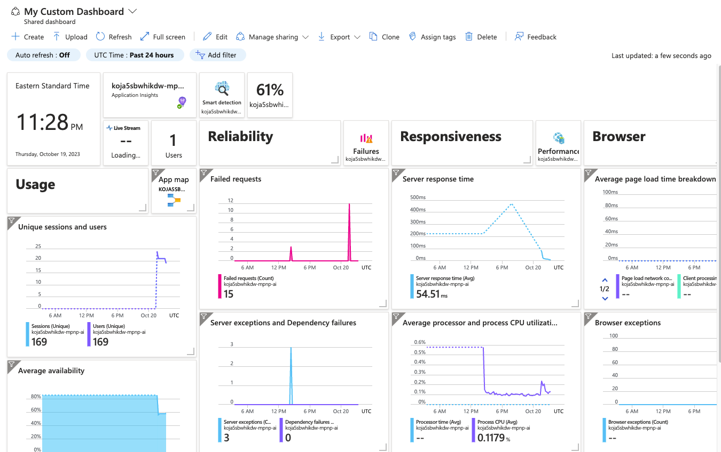
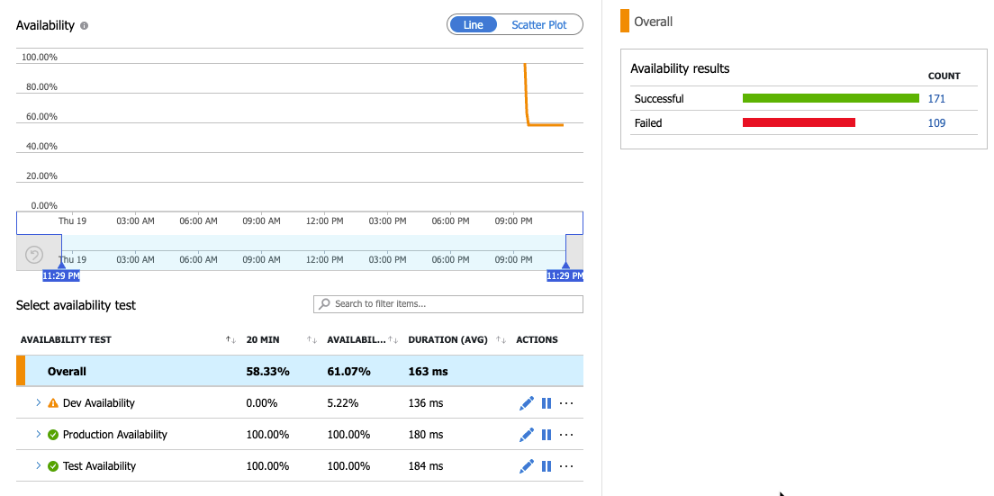
Monitor the Application
With the data from the application being logged to Log Analytics, you can create dashboards and monitoring.
In this section, you’ll work with app insights
Customize the App Insights Dashboard
Setup availability monitoring
View availability alerting
Notes:
Speaker notes:
Now that you’ve setup Security and monitoring and protecting your code, we’ll take a quick look at what you can do to monitor the application once it’s been deployed to App Services.
App Insights is the Azure Service used for monitoring applications in App Services. There used to be two ways to deploy App Insights, either with or without a Log Analytics Workspace. Microsoft has announced the end of availability for non-Log Analytics based monitoring, so any app insights instances still not converted to a Log Analytics workspace should be converted over.
App Insights gives you the ability to:
- Have a default app insights dashboard to monitor various data points about your web application
- Customize and create new dashboards so you can tailor the App Insights dashboard to your specific needs.
- Setup availability alerting to help you know, before your customers, if there is an issue with your application that causes it to go offline.

